Slide 1

Group Project 2
Group Members: Issa Habeeb, Ali Algahim, Emran Ali, George Ebaugh, Munassar Shariff, Nadia Aktar, Rasheed Kareem

Slide 2

Tasks
Issa Habeeb: Front End
Ali Algahim: Coding
Emran Ali: Coding
George Ebaugh: Coding
Munassar Shariff: Written document
Nadia Aktar: Written document
Rasheed Kareem: Coding

Slide 3
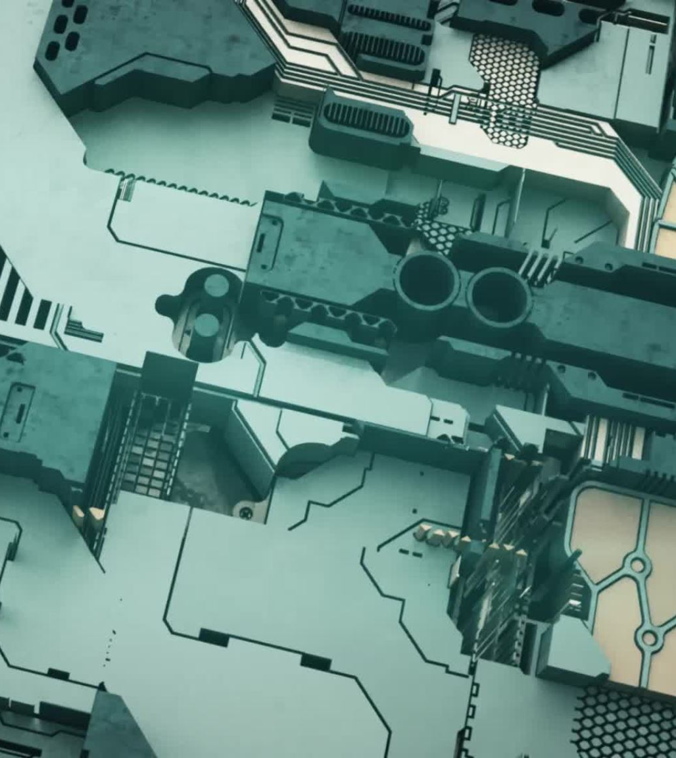
Project overview
Create a game like the popular arcade game space invaders using turtle.
Create a tkinter gui to create a menu for the game
Create new branch for project two on webpage

Slide 4

Software
HTML- The structure, and elements (such as header, body, footer) of the website.
CSS- Styling for the elements.
VS code- Text editor.
Python- Programming language used to write the code.
Tkinter- Graphical user interface.
Pylint- Checked Code and Followed Requirements.
Pyinstaller- Made it into an exe

Slide 5
Website and Demo showcase

Slide 6
Difficulties
Getting an animated gif to work for the menu screen.
Having to scale down a gif for it to fit into the turtle graphic.
Collision detection and Enemy behavior.

Slide 7

Why choose us?
The gui has adaptability meaning that other games could be added to the menu.
Retro game remakes always have a market of players interested.
We have diverse skillsets that allow us to work together and break down complex projects.

Slide 8
Questions?

